Slide 1

Analyzing the Performance of Linear and Nonlinear
Multi-Period Optimal Power Flow Models
for Active Distribution Systems
Paper ID: 775
Presenter: Subho Paul
Authors: Aryan Jha¹, Subho Paul² & Anamika Dubey¹
¹School of Electrical Engineering & Computer Science, Washington State University, Pullman, WA, United States
²Department of Electrical Engineering, Indian Institute of Technology (BHU) Varanasi, Varanasi, UP, India
Paper ID: 775
Date: 04-July-2025

Slide 2
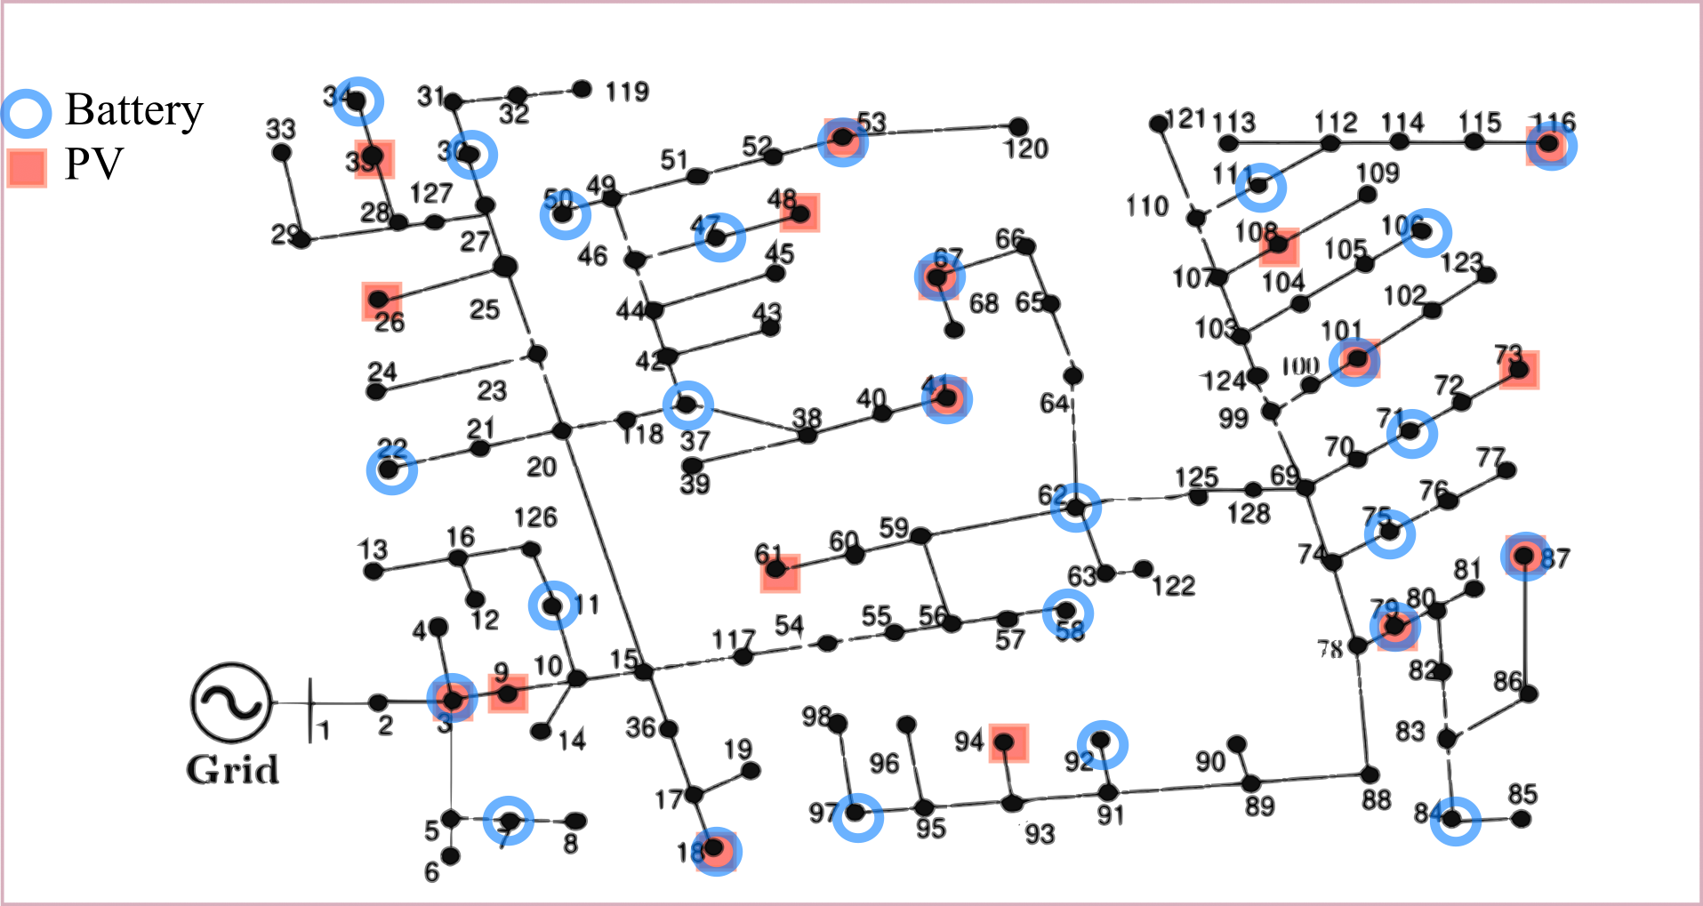
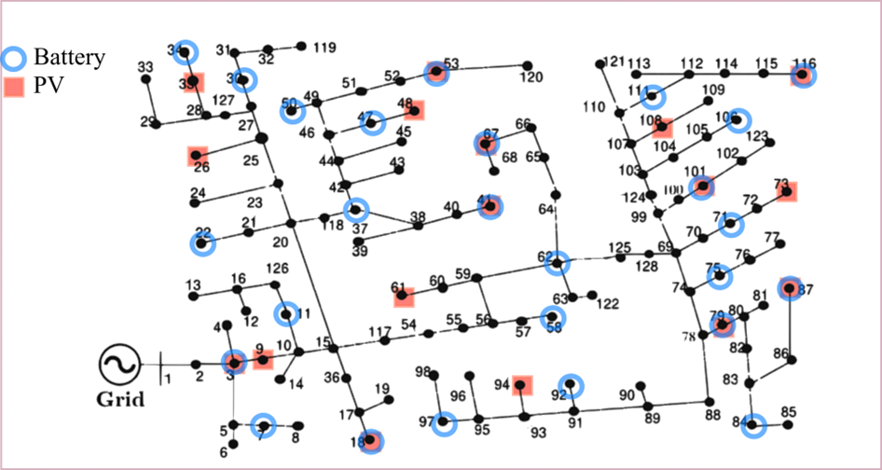
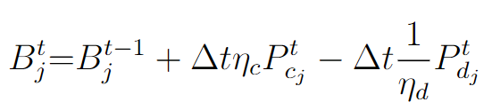


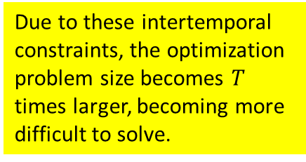
The Multi Period Optimal Power Flow (MPOPF) problem for Active Distribution Systems
$min.$Desired Objective Function
Controllable Components: Grid Edge Devices (GEDs) like Batteries and PVs spread throughout whose real and reactive dispatch may be set every time-period
$$subject to$$
Network Constraints
Engineering Constraints
Component Constraints (DERs, Batteries)
Intertemporal Constraints
Intertemporal Constraints
Intertemporal Constraints
Set Points
Set Points
Set Points
Due to these intertemporal constraints, the optimization problem size becomes $T$ times larger, becoming more difficult to solve.
Battery SOC Equation
In this paper we are comparing the effectiveness of two models: The Nonlinear Branch Flow Model (BFM-NL) and LinDistFlow (LDF) for solving the MPOPF problem
An example of
is
Paper Id: 775

Slide 3
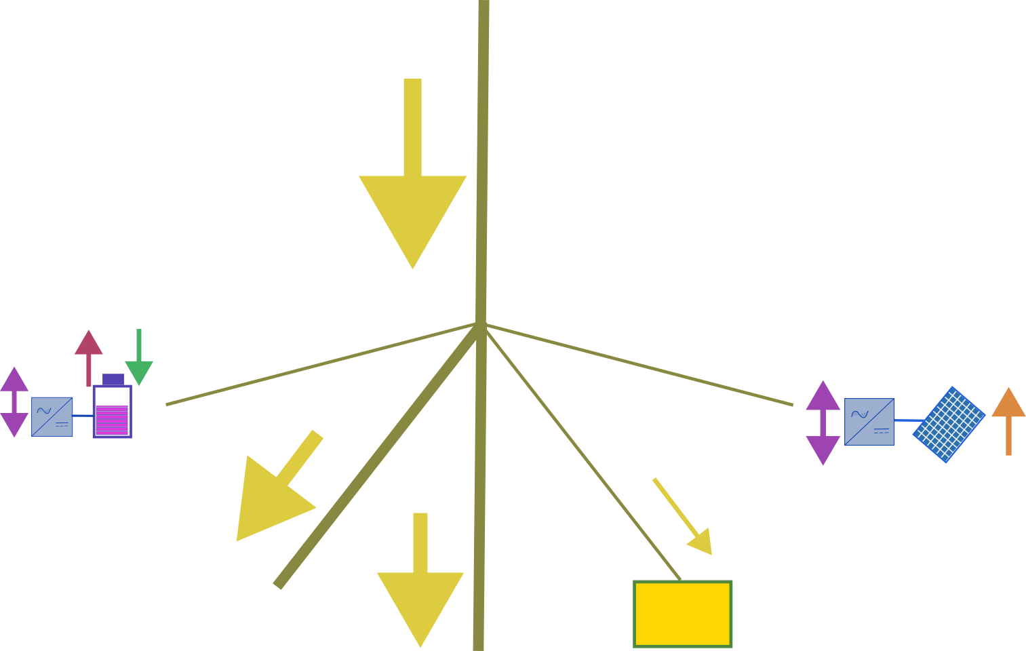







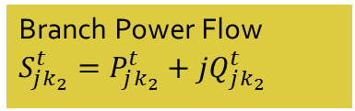
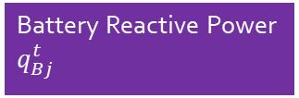


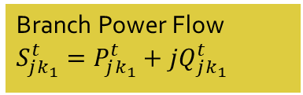



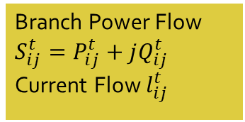
Bus $i$:$v_{i}^{t}={\left(V_{i}^{t}\right)}^{2}$
Branch Power Flow $S_{ij}^{t}=P_{ij}^{t}+jQ_{ij}^{t}$
Current Flow $l_{ij}^{t}$
Network Constraints
Branch $(i, j)$
Discharging Power $P_{dj}^{t}$
Charging Power $P_{cj}^{t}$
Bus $j$:$v_{j}^{t}={\left(V_{j}^{t}\right)}^{2}$
PV Real Power $P_{Dj}^{t}$
Battery Reactive Power $q_{Bj}^{t}$
Branch $(j, k_{1})$
Branch $(j, k_{2})$
PV Reactive Power $q_{Dj}^{t}$
Bus $k_{1}$
Branch Power Flow $S_{jk_{1}}^{t}=P_{jk_{1}}^{t}+jQ_{jk_{1}}^{t}$
Bus $k_{2}$
Load $P_{Lj}^{t}+jQ_{Lj}^{t}$
Branch Power Flow $S_{jk_{2}}^{t}=P_{jk_{2}}^{t}+jQ_{jk_{2}}^{t}$
Paper Id: 775

Slide 4
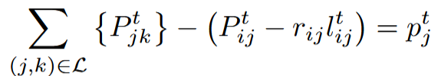
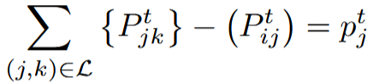
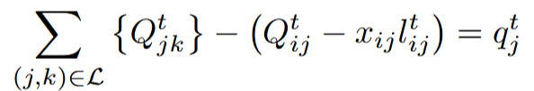
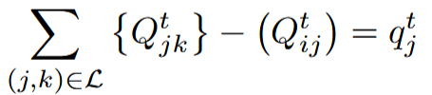
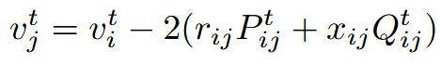
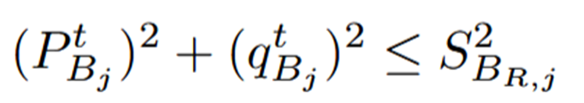
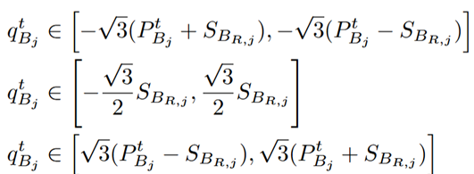
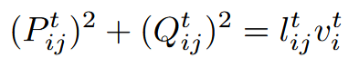
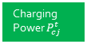




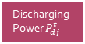


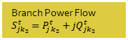



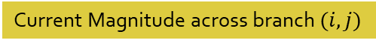

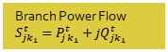



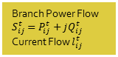

Network Constraints – BFM-NL vs LDF
Bus $i$:$v_{i}^{t}={\left(V_{i}^{t}\right)}^{2}$
Branch Power Flow $S_{ij}^{t}=P_{ij}^{t}+jQ_{ij}^{t}$
Current Flow $l_{ij}^{t}$
Branch $(i, j)$
BFM-NL
LDF
Discharging Power $P_{dj}^{t}$
Charging Power $P_{cj}^{t}$
Bus $j$:$v_{j}^{t}={\left(V_{j}^{t}\right)}^{2}$
PV Real Power $P_{Dj}^{t}$
Node $j$ Real Power Balance
Battery Reactive Power $q_{Bj}^{t}$
Branch $(j, k_{1})$
Branch $(j, k_{2})$
PV Reactive Power $q_{Dj}^{t}$
Node $j$ Reactive Power Balance
Bus $k_{1}$
Branch Power Flow $S_{jk_{1}}^{t}=P_{jk_{1}}^{t}+jQ_{jk_{1}}^{t}$
Bus $k_{2}$
Load $P_{Lj}^{t}+jQ_{Lj}^{t}$
Branch Power Flow $S_{jk_{2}}^{t}=P_{jk_{2}}^{t}+jQ_{jk_{2}}^{t}$
KVL across branch $(i, j)$
Common
Battery SOC Equation
Battery Reactive Power Limits
Only BFM-NL
Current Magnitude across branch $(i, j)$
Paper Id: 775

Slide 5
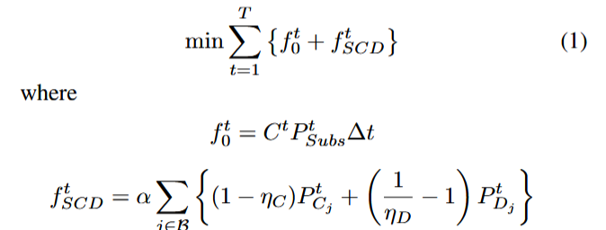
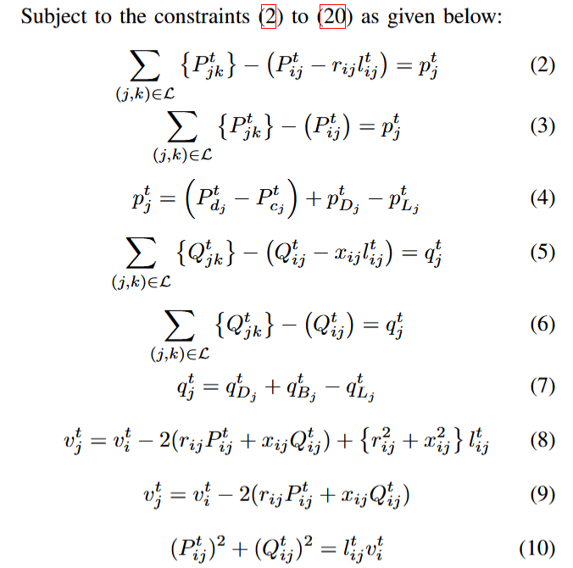
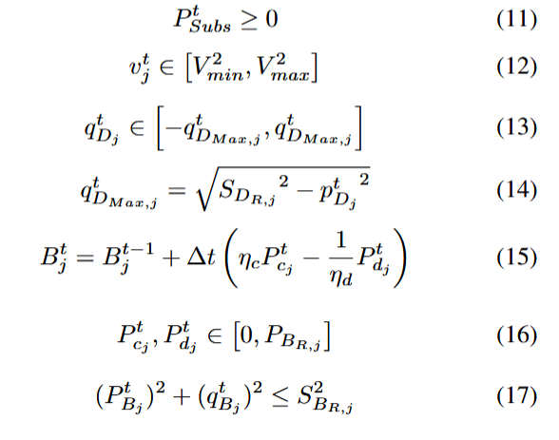
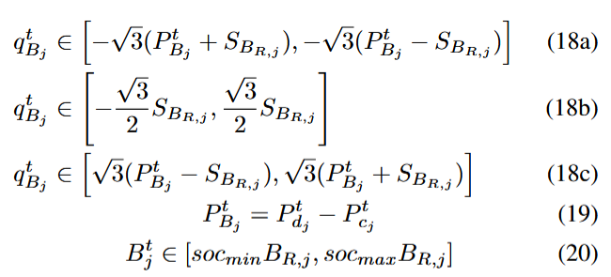
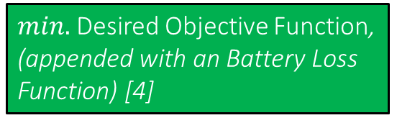

Full Optimization Model – Balanced Three-Phase Nonlinear OPF
Bus $i$:$v_{i}^{t}={\left(V_{i}^{t}\right)}^{2}$
Branch Power Flow $S_{ij}^{t}=P_{ij}^{t}+jQ_{ij}^{t}$
Current Flow $l_{ij}^{t}$
Branch $(i, j)$
$min.$Desired Objective Function, (appended with an Battery Loss Function) [4]
Objective
Discharging Power $P_{dj}^{t}$
Charging Power $P_{cj}^{t}$
Bus $j$:$v_{j}^{t}={\left(V_{j}^{t}\right)}^{2}$
PV Real Power $P_{Dj}^{t}$
Battery Reactive Power $q_{Bj}^{t}$
Branch $(j, k_{1})$
$$subject to$$
Branch $(j, k_{2})$
PV Reactive Power $q_{Dj}^{t}$
Network Constraints
Network Constraints
Bus $k_{1}$
Engineering Constraints
Branch Power Flow $S_{jk_{1}}^{t}=P_{jk_{1}}^{t}+jQ_{jk_{1}}^{t}$
Bus $k_{2}$
Load $P_{Lj}^{t}+jQ_{Lj}^{t}$
Component Constraints (DERs, Batteries)
Branch Power Flow $S_{jk_{2}}^{t}=P_{jk_{2}}^{t}+jQ_{jk_{2}}^{t}$
PV and Battery Real Power Constraints
Battery Reactive Power Constraints
Paper Id: 775

Slide 6
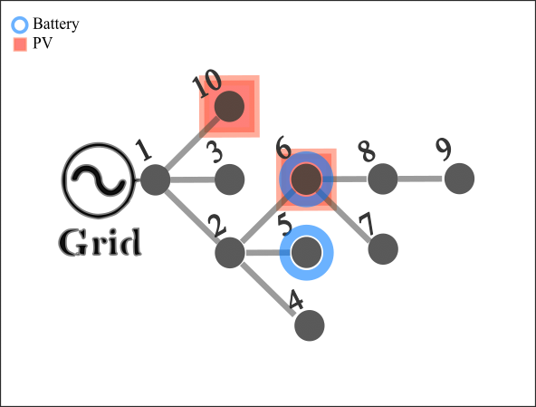
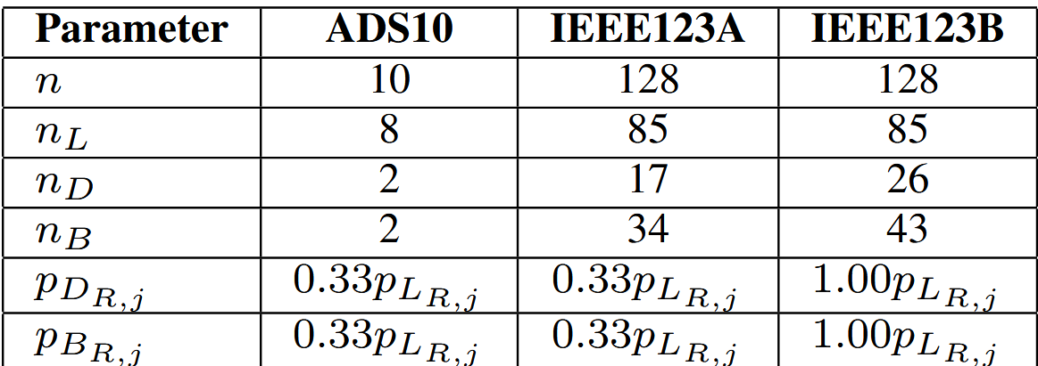
Test Systems
ADS10 – A small Active Distribution System
IEEE123A and IEEE123B – Two versions of the IEEE123 Test System with varying levels of GED penetration
(Shown here: IEEE123A)
Paper Id: 775

Slide 7
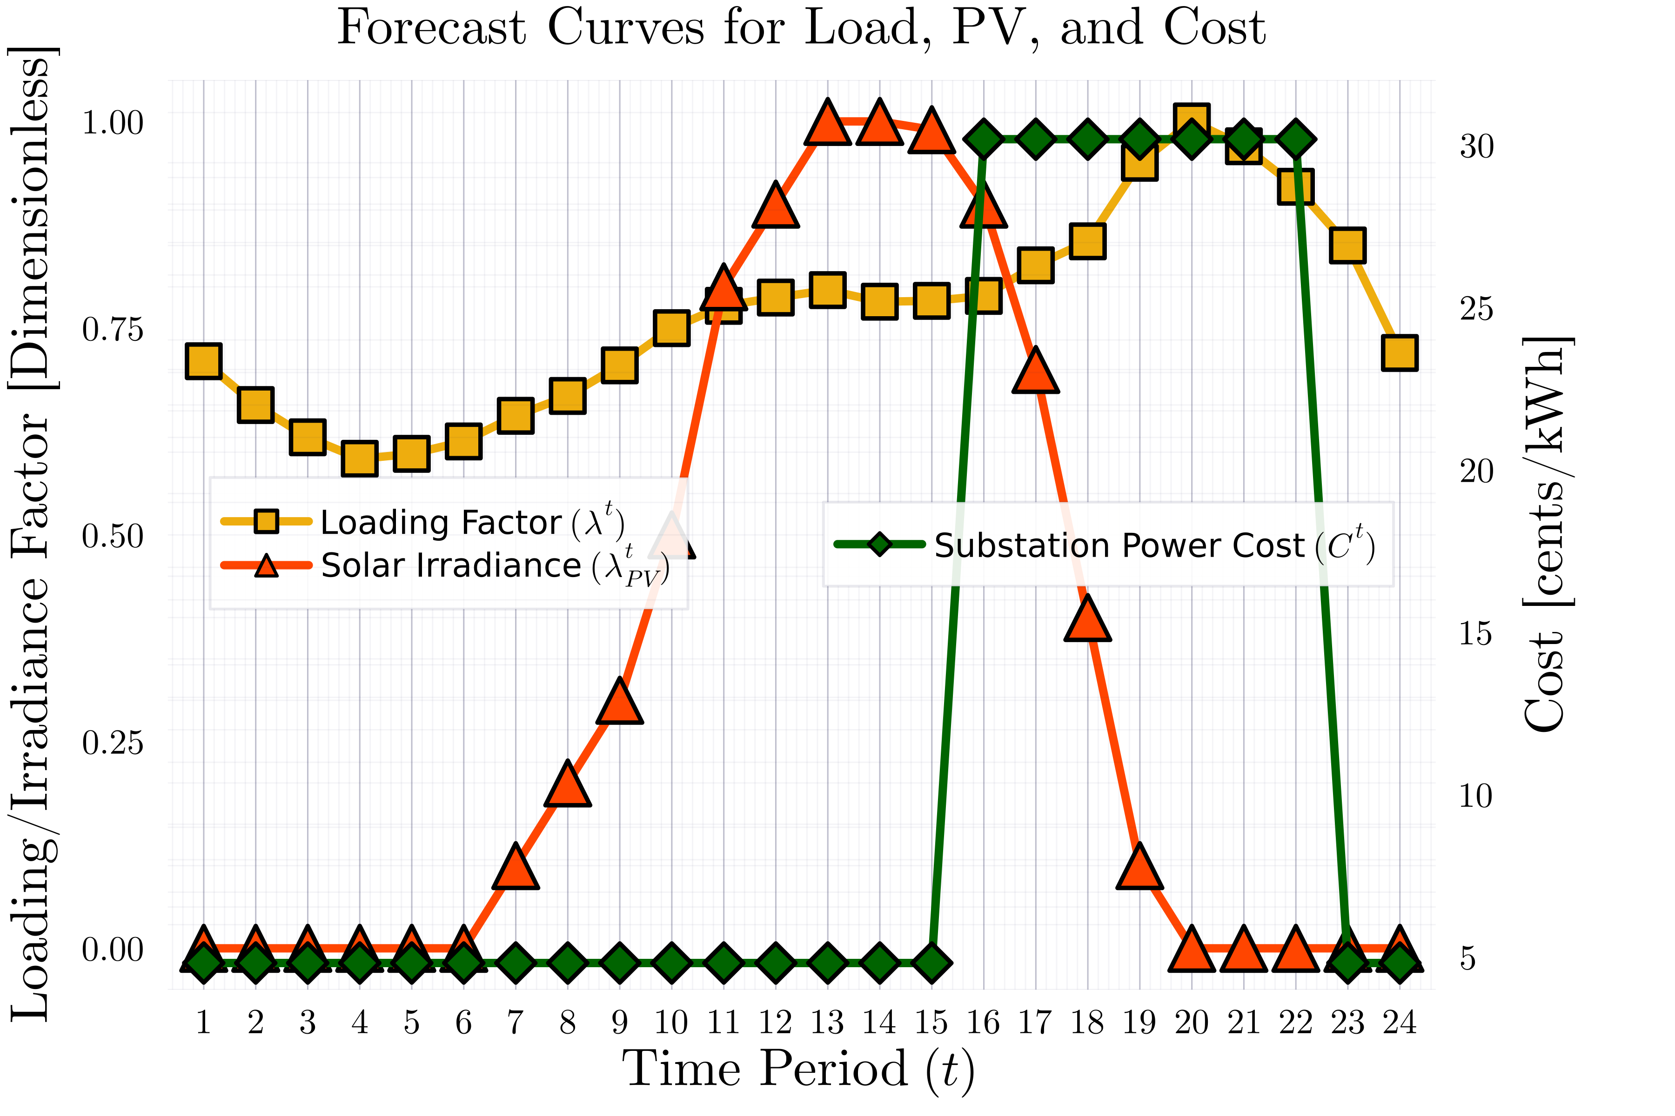
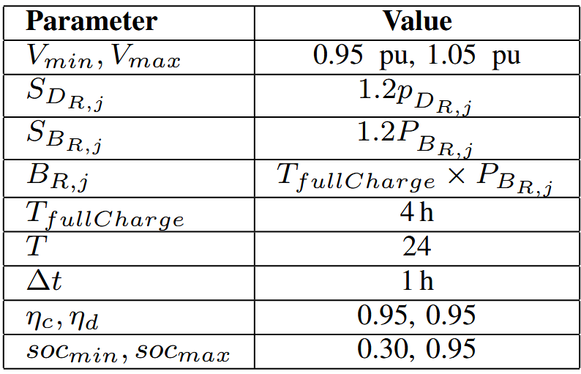
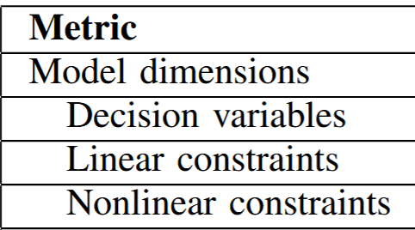
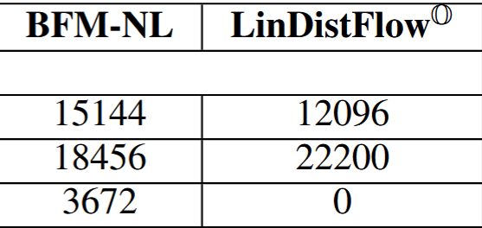
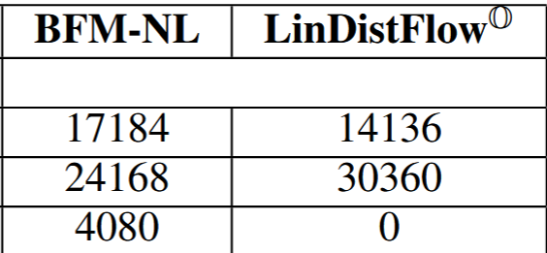
MPOPF Simulation Parameters
Horizon Duration: 24h
Time Period: 1h
Programming Language: Julia
Optimization Modelling Language: JuMP
Optimization Solver: Ipopt
Plant Simulator: OpenDSS
Decision Variables: Upto 17k
Linear Constraints: Upto 30k
Nonlinear Constraints: Upto 14k
IEEE123A
IEEE123B
Paper Id: 775

Slide 8
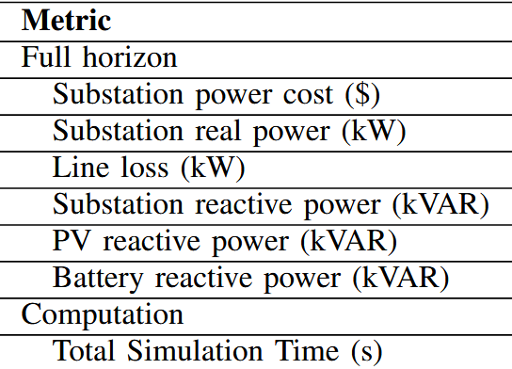
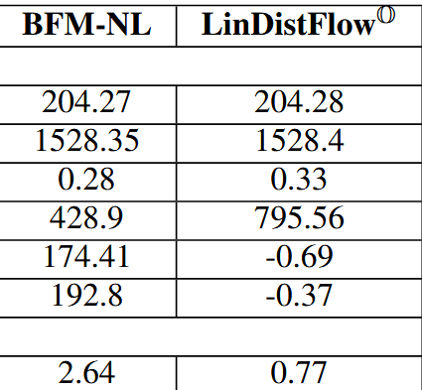
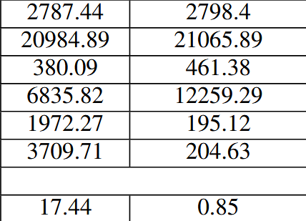
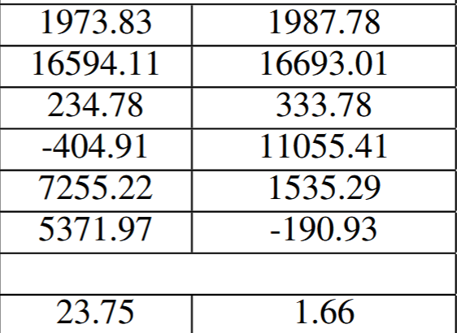
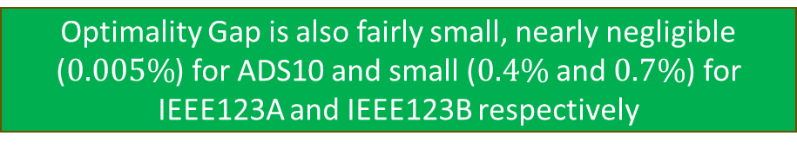
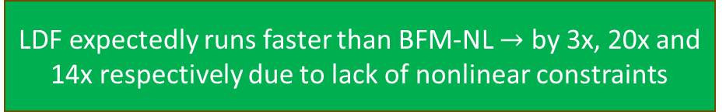
Results – Performance Comparison of BFM-NL vs LDF
ADS10
IEEE123A
IEEE123B
LDF expectedly runs faster than BFM-NL $→$ by 3x, 20x and 14x respectively due to lack of nonlinear constraints
Optimality Gap is also fairly small, nearly negligible ($0.005\%$) for ADS10 and small ($0.4\%$ and $0.7\%$) for IEEE123A and IEEE123B respectively
Note: BFM-NL is not warm-started with LDF results, doing which may have had narrowed the simulation time gaps
Reactive Power allocated by LDF somewhat arbitrary, under-utilizing GED reactive powers and borrowing almost entirely from the substation to supply grid demand
Paper Id: 775

Slide 9
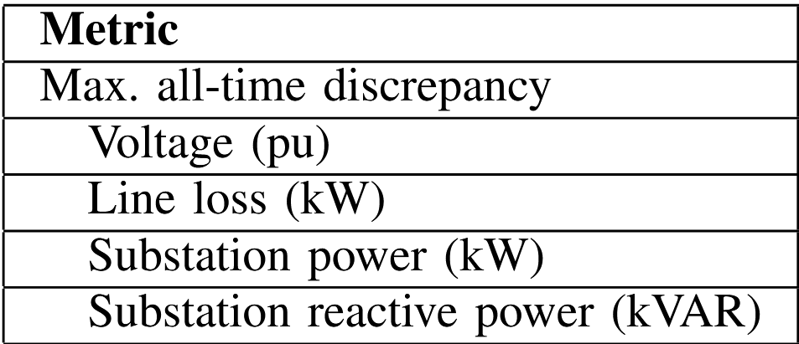
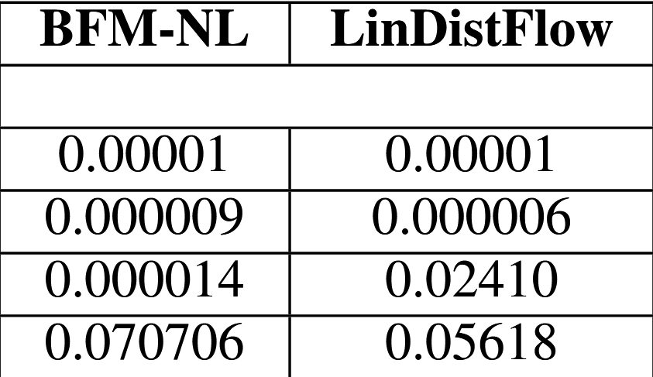
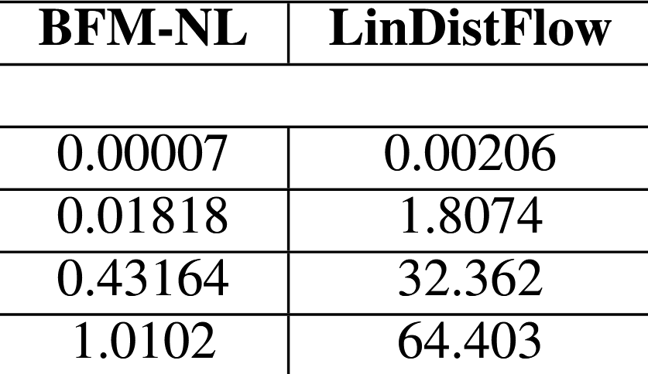
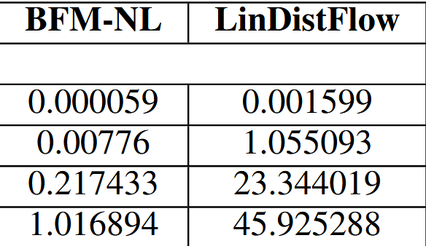

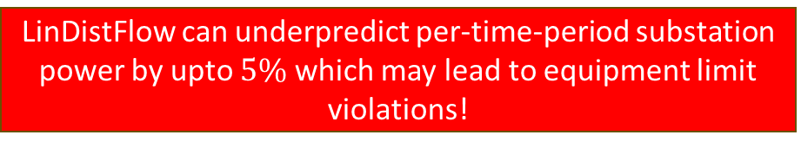
Results – Discrepancy Comparison of BFM-NL vs LDF
ADS10
IEEE123A
IEEE123B
ADS10 – Almost no discrepancies
IEEE123A and IEEE123B – Significant Deviation from true values of Substation Real and Reactive Powers
LinDistFlow keeps Nodal Voltage Error under $0.2\%$ compared to BFM-NL $→$ generally acceptable
LinDistFlow can underpredict per-time-period substation power by upto $5\%$ which may lead to equipment limit violations!
Paper Id: 775

Slide 10
Conclusion –
Complementary Modelling Benefits
LinDistFlow’s approximations are susceptible to the degree of nonlinear constraint causing components in the grid – the higher the penetration of reactive power enabled batteries, the more the optimality gap
LinDistFlow is relatively fast in providing control set points for GEDs. However it is important to pass the set points through a true nonlinear Powerflow solver, such as OpenDSS so as to avoid any unknown constraint violations such as any for substation power
Branch Flow Model – Nonlinear may be warm-started via the results of LinDistFlow for faster but more feasible and optimal results
Thus, depending on the use case (real-time constraints and infeasibility tolerance limits) a hybrid approach could be employed for best results
Paper Id: 775
04/07/2025
0x/15

Slide 11


Paper Id: 775
04/07/2025
0x/15

